Slide 1
COLLEGE NAME : RAJIV GANDHI COLLEGE OF ENGINEERING-2119
NAME : POOVARASAN G
211921104012
PROJECT NAME:MEDIA STREAMING WITH IBM CLOUD VEDIO STREAMING

Slide 2
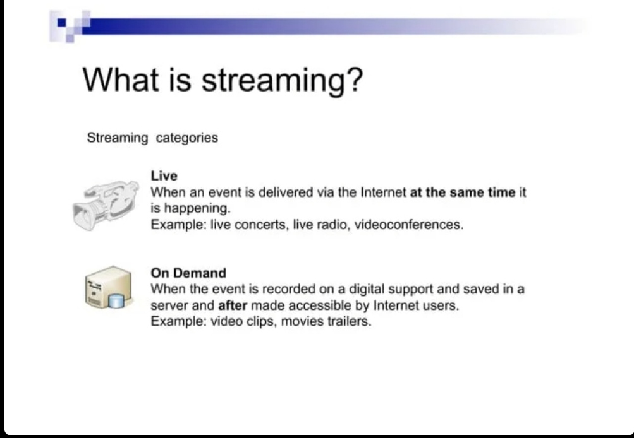

Slide 3
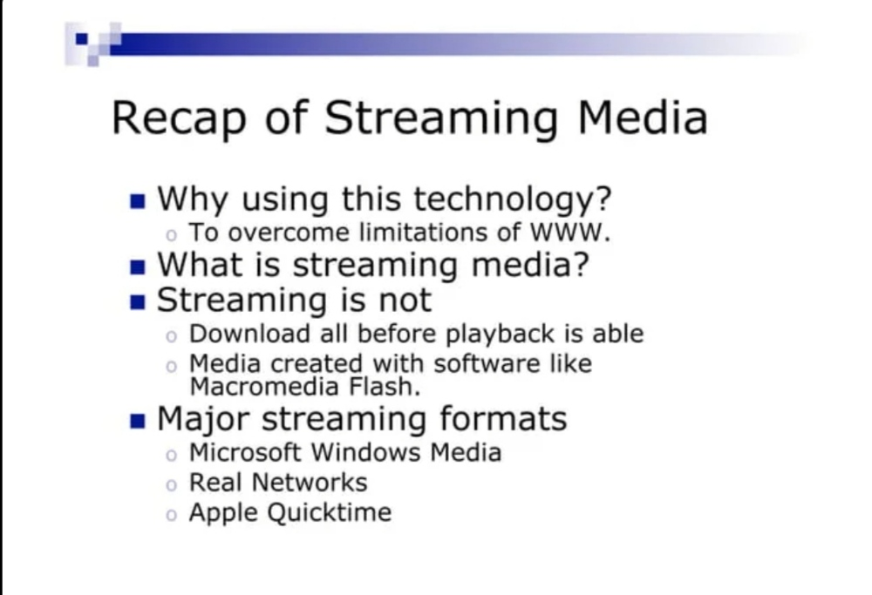

Slide 4
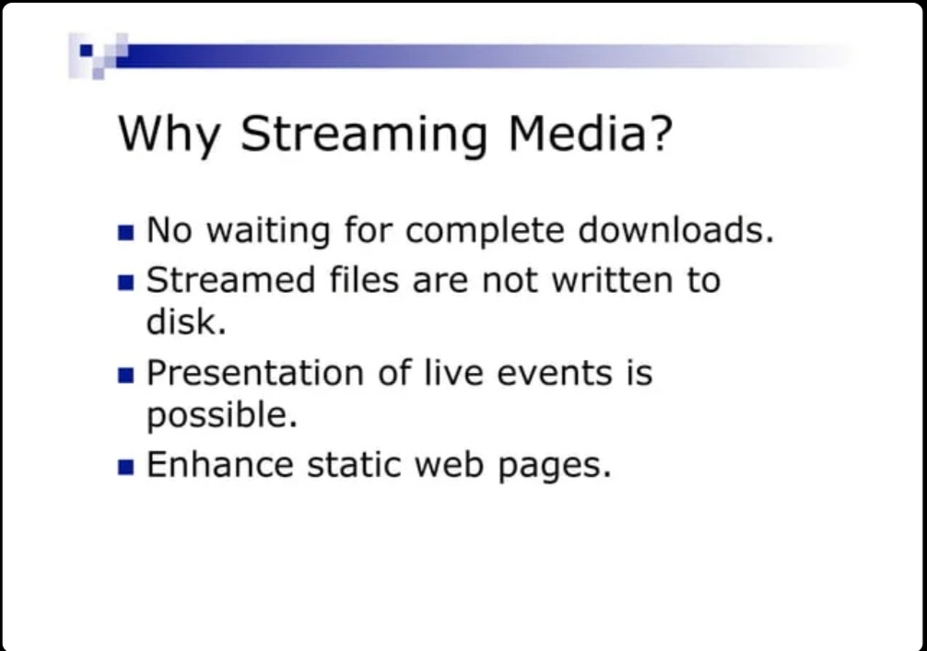

Slide 5
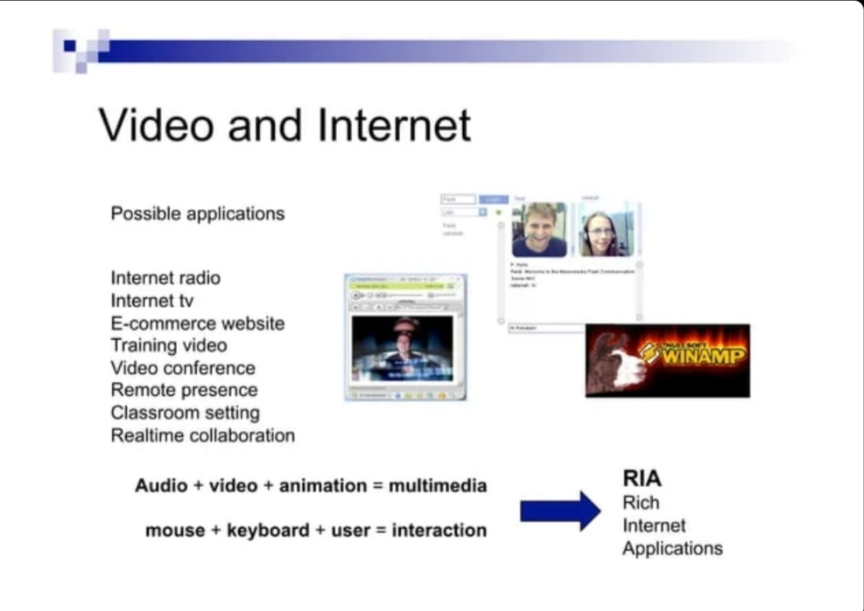

Slide 6
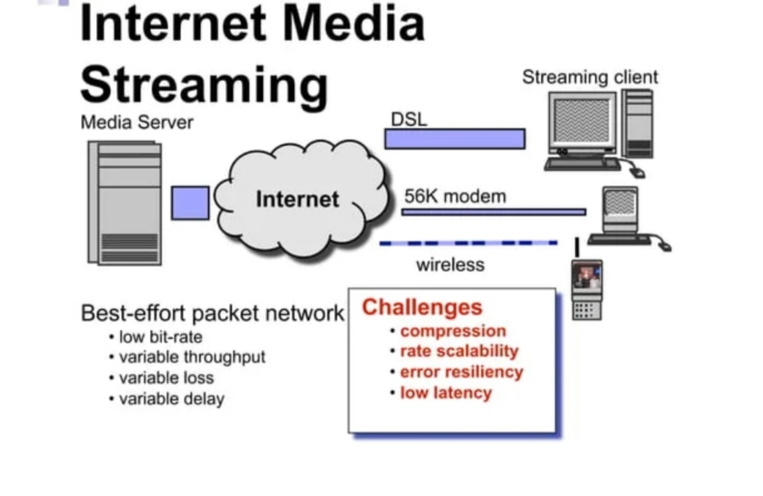

Slide 7
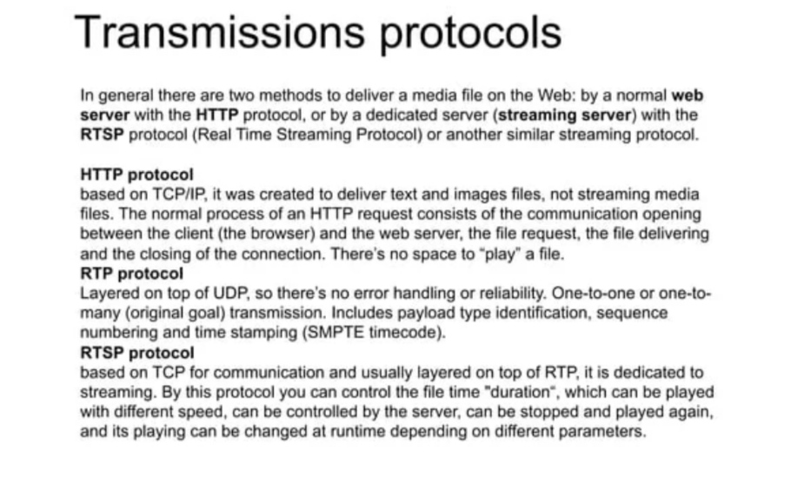

Slide 8
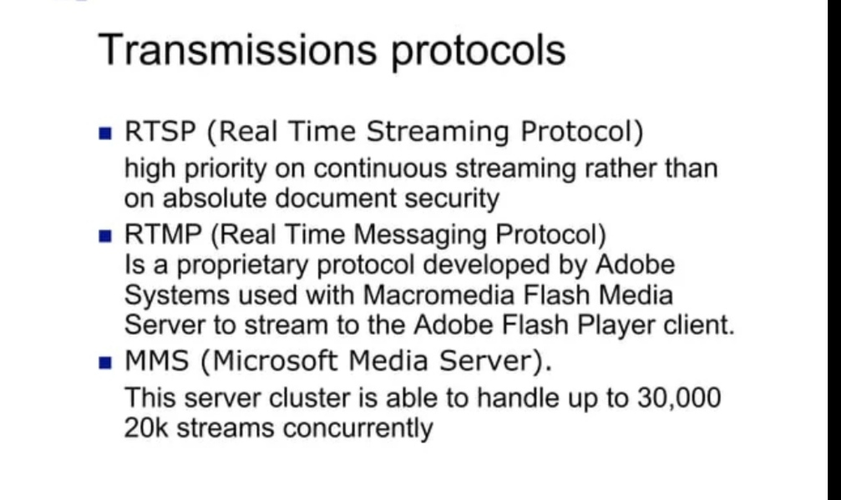

Slide 10
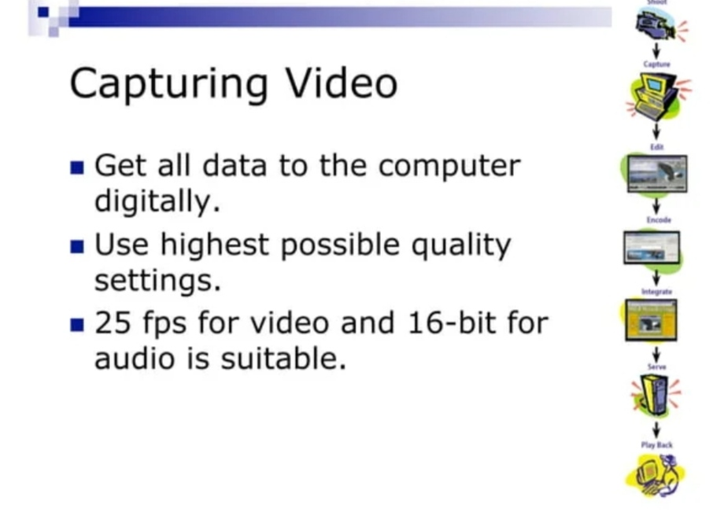

Slide 12
